Slide 1
Viral Properties - Statistical and Epidemiological Information
Autumn Dompke, Austin Flint, Colin Quinn

Slide 2
Overview:
Autumn Dompke:
How many people have actually been infected? (U.S)
How many cases of COVID-19 are there in Michigan compared to the U.S.?
Austin Flint:
What is the basic reproductive number for Covid-19?
Will new vaccines need to be made to fit COVID mutations similar to the flu shot?
Colin Quinn:
What is the minimum percent of population required to be vaccinated in order to achieve herd immunity?
Are enough people willing to receive the vaccine to reach the point of herd immunity?

Slide 3
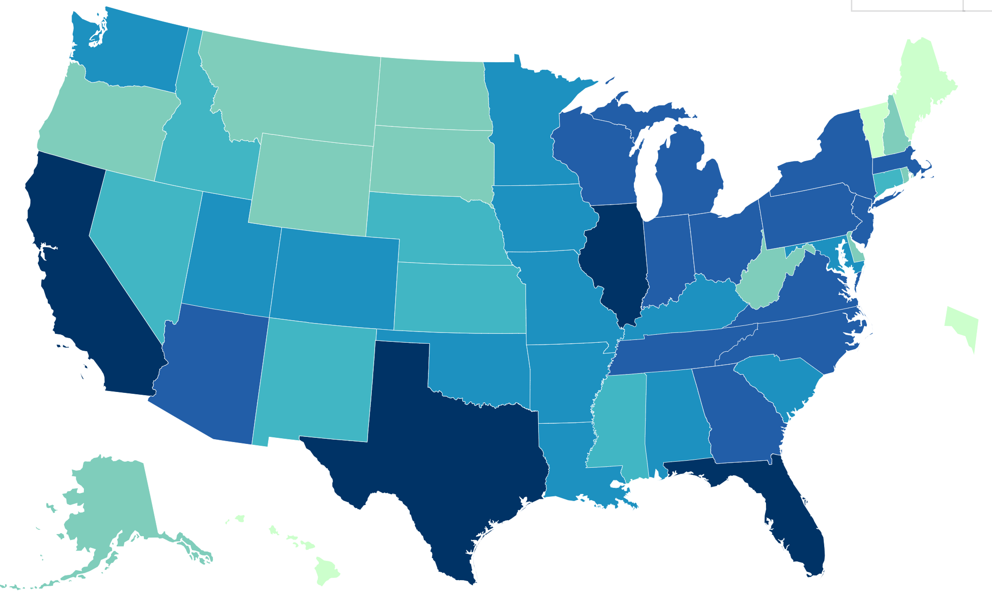
How many people have actually been infected? (U.S.)
Notes:
We know that the virus has done enough damage to be labeled as a pandemic, but how many people have actually been infected by the COVID-19 virus in the U.S.?

Slide 4

Information:
Estimated COVID-19 Burden
https://www.cdc.gov/coronavirus/2019-ncov/cases-updates/burden.html
Notes:
This information was provided by the Center for Disease Control and Prevention, which is led by a team of physicians, scientists, and epidemiologists who aim to save lives and help protect people from health, safety, and security threats. This information in particular is to report the estimated COVID-19 burden in the United States.

Slide 5
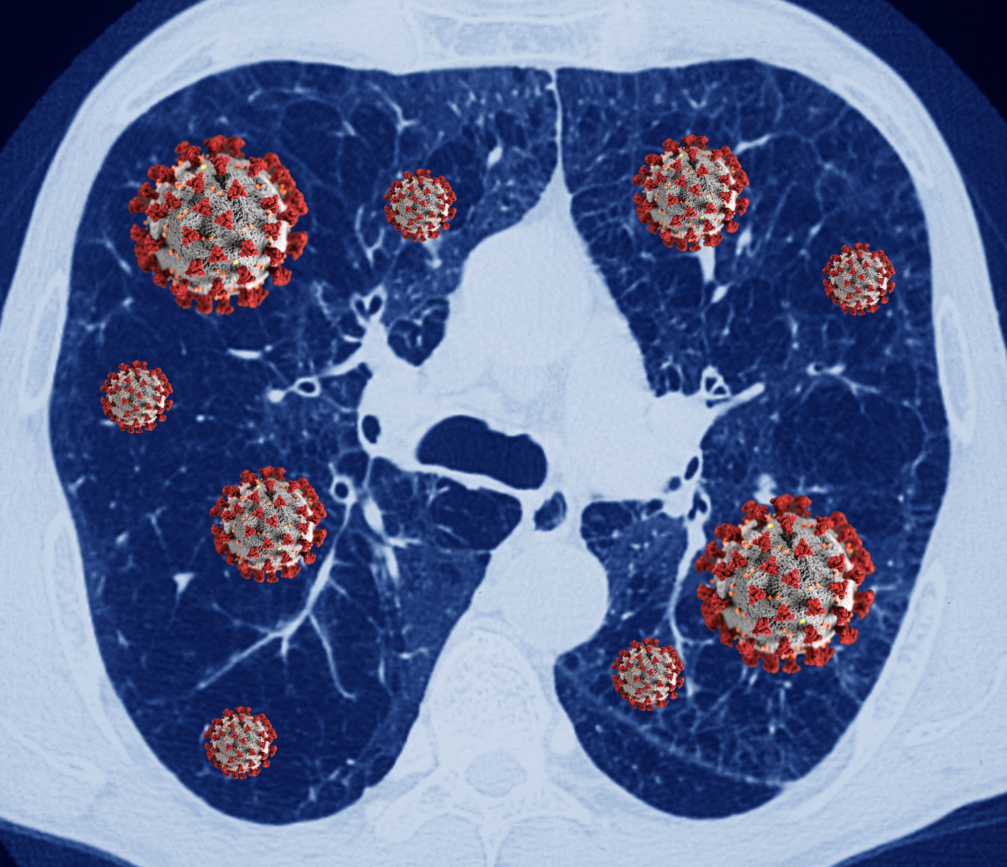
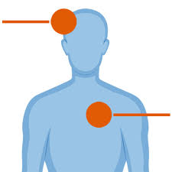

Purpose:
To estimate the number of
Infections
Symptomatic illnesses
Hospitalizations
Notes:
The purpose is to better reflect the burden of COVID-19 in which the CDC aims to estimate the number of “infections, symptomatic illnesses, and hospitalizations using a statistical model to adjust for cases that national surveillance networks are unable to capture”.

Slide 6
Main Findings and Conclusions:
1 in 4.6
83.1 Million
1 in 4.2
70.4 Million
1 in 1.9
4.1 Million
Notes:
The CDC estimates that from February-December 2020: 1 in 1.9 Covid-19 hospitalizations were reported. 1 in 4.2 Covid-19 symptomatic illnesses were reported. and 1 in 4.6 total Covid-19 infections were reported.
These estimates suggest that during that period, there were approximately: 83.1 million estimated total infections. 70.4 million estimated symptomatic illnesses. and 4.1 million estimated hospitalizations.
In the early stages of the COVID-19 pandemic, as is generally the case with the emergence of a novel virus like SARS-CoV-2, data on testing, detection, and case reporting, which are necessary for estimating the true burden of a disease were lacking or not available.
More specifically, in some heavily affected areas of the United States, the size of the COVID-19 outbreak quickly exceeded the capacity of health systems to complete detailed reporting on cases that included information like the age of the patient and whether or not they were hospitalized.
This led to case reports sent to CDC that were missing vital patient information. CDC had to estimate the age and hospitalization status of patients with missing data based on cases with known information on age and hospitalization status.

Slide 7
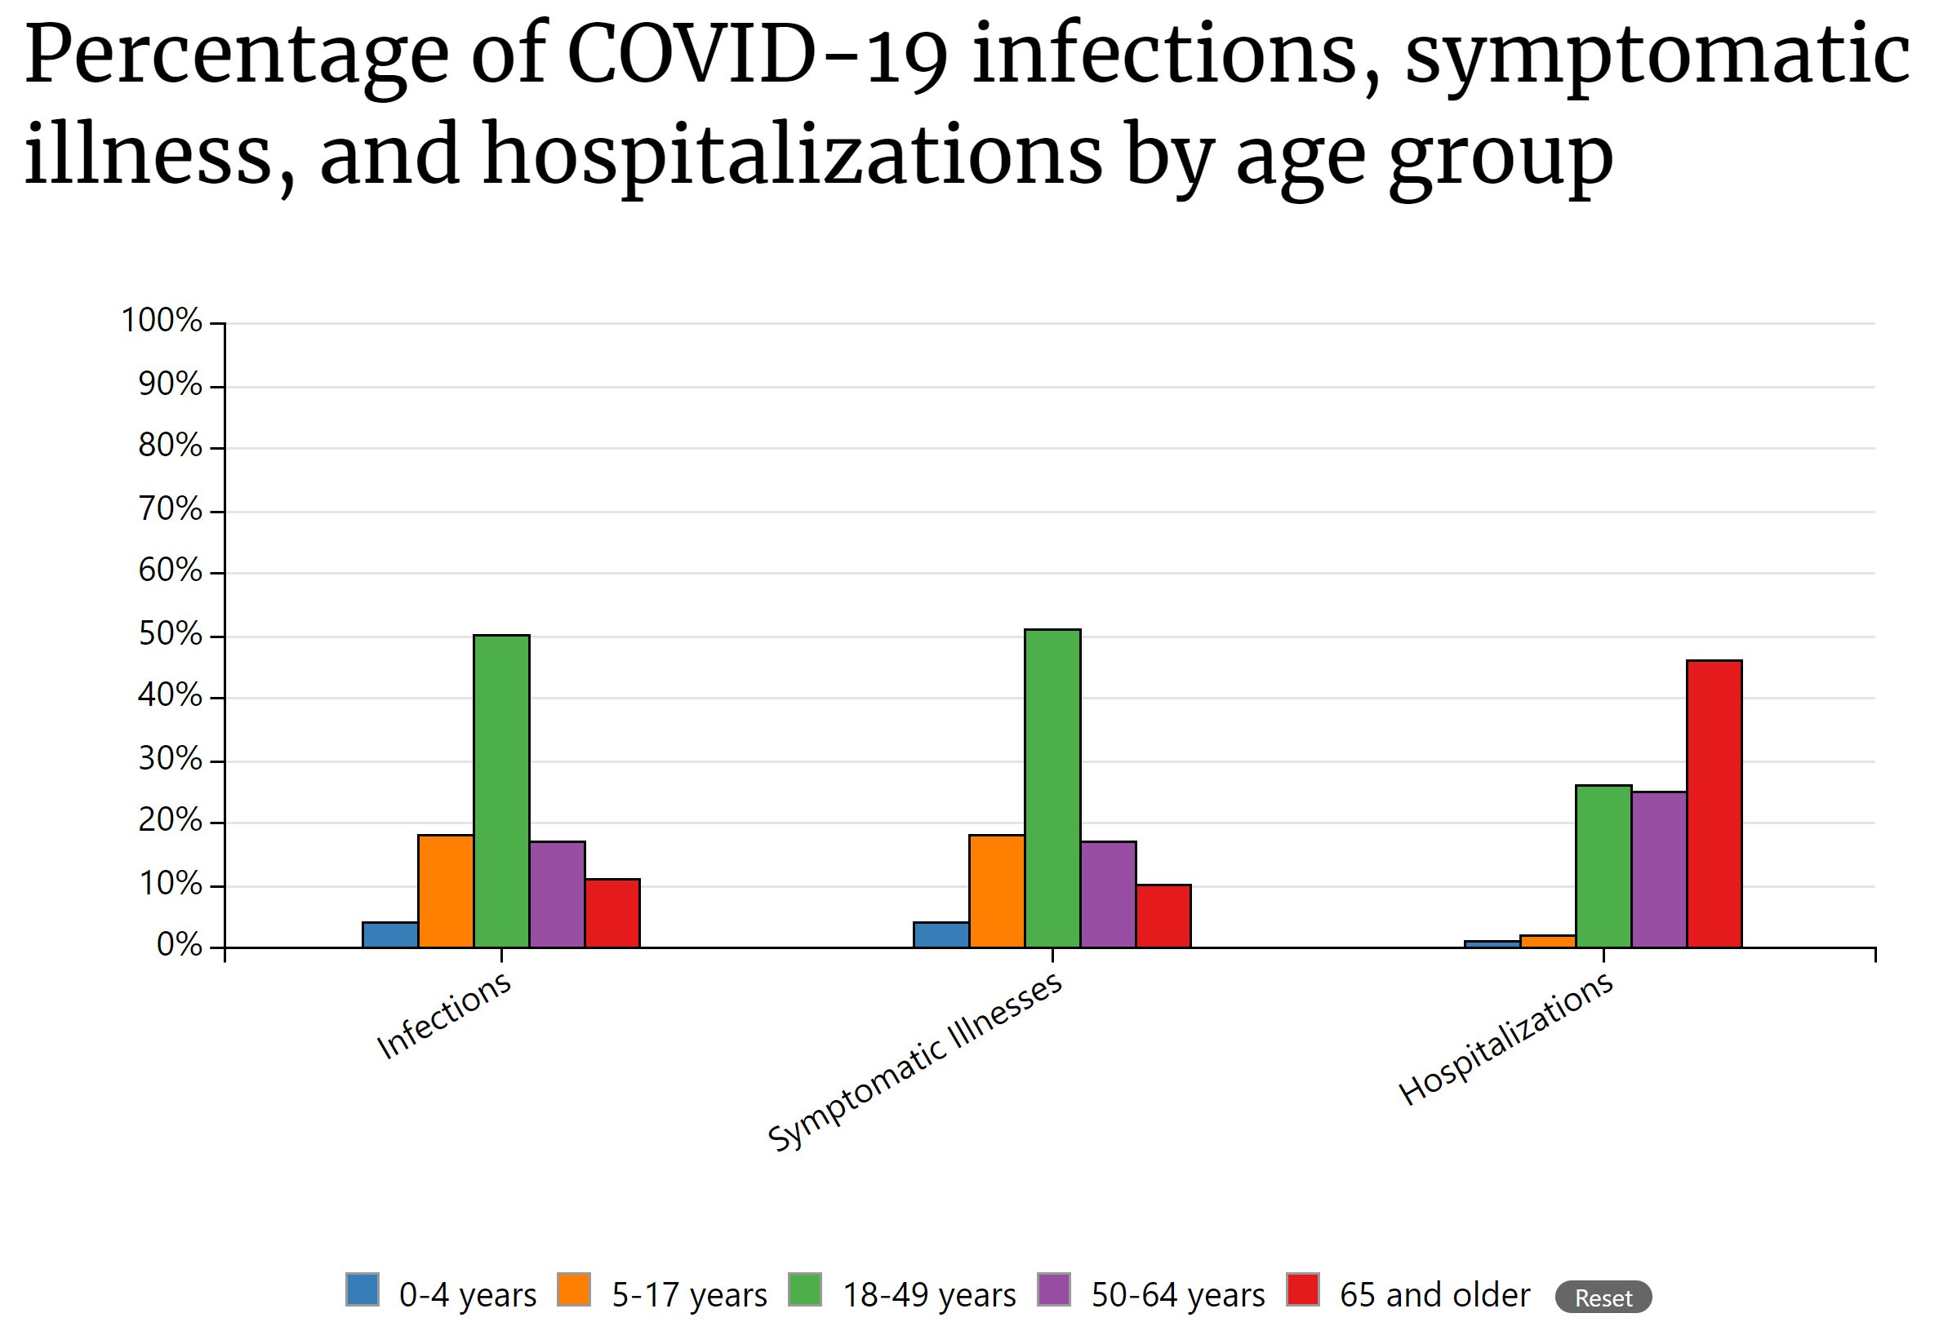
Notes:
These statistics are broken down even further, reporting the percentage of COVID-19 infections, symptomatic illness, and hospitalizations (by age group).
As you can see here, the number of infections, symptomatic illnesses, and hospitalizations from 0-4 years was pretty low 4% 4% 1%. From 5-17 years, it raised to 18% 18% and 2%. The highest number of infections and symptomatic illnesses in a group was in the 18-49 years age group and resulted in 50% 51% and 26%. In the 50-64 years age group there was 17% 17% 25%. And finally in the 65 and older age group there were 11% 10% and a staggering 46%.
There are many things that can be learned from these estimates, some include: That the estimation of unreported cases helps to quantify the impact and severity of the COVID-19 pandemic on the healthcare system and society, as well as the estimates can inform how to direct and allocate hospital resources and assist in planning for prevention and control measures. It should also be noted that these are estimates and are subject to several limitations. Some of these limitations were included in my previous post and are important to keep in mind.

Slide 8
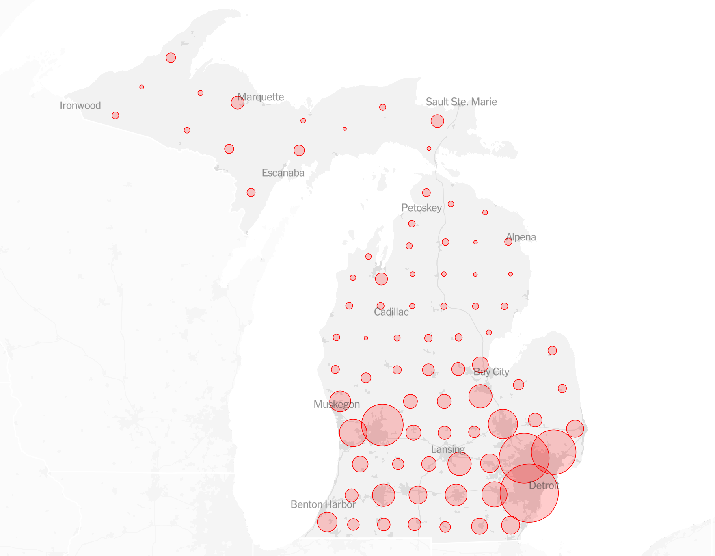
How many cases of COVID-19 are there in Michigan compared to the U.S.?
Notes:
Now that we know the approximate number of cases in the U.S., how many cases of COVID-19 are there in Michigan comparatively?

Slide 9

Information:
Michigan Coronavirus Map and Case Count
https://www.nytimes.com/interactive/2020/us/michigan-coronavirus-cases.html#map
Notes:
This information was provided by The New York Times, which is an American daily newspaper with worldwide readership. This information in particular is to report the Michigan coronavirus case count with

Slide 10
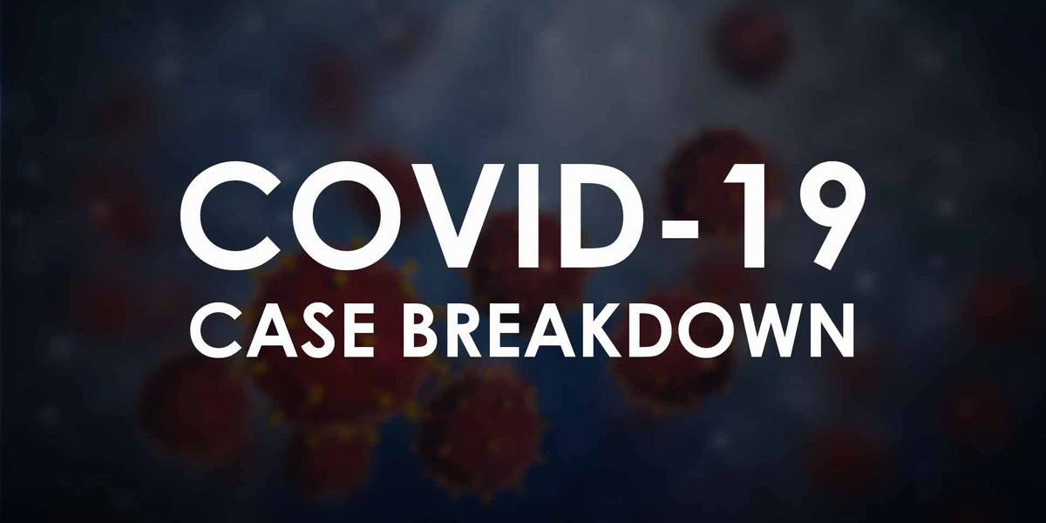
Purpose:
Notes:
The purpose of the article from the New York Times about the Michigan COVID-19 cases is to inform their audience about the number of new cases reported, the total cases, the number of hospitalizations, and the death count in the state.

Slide 11
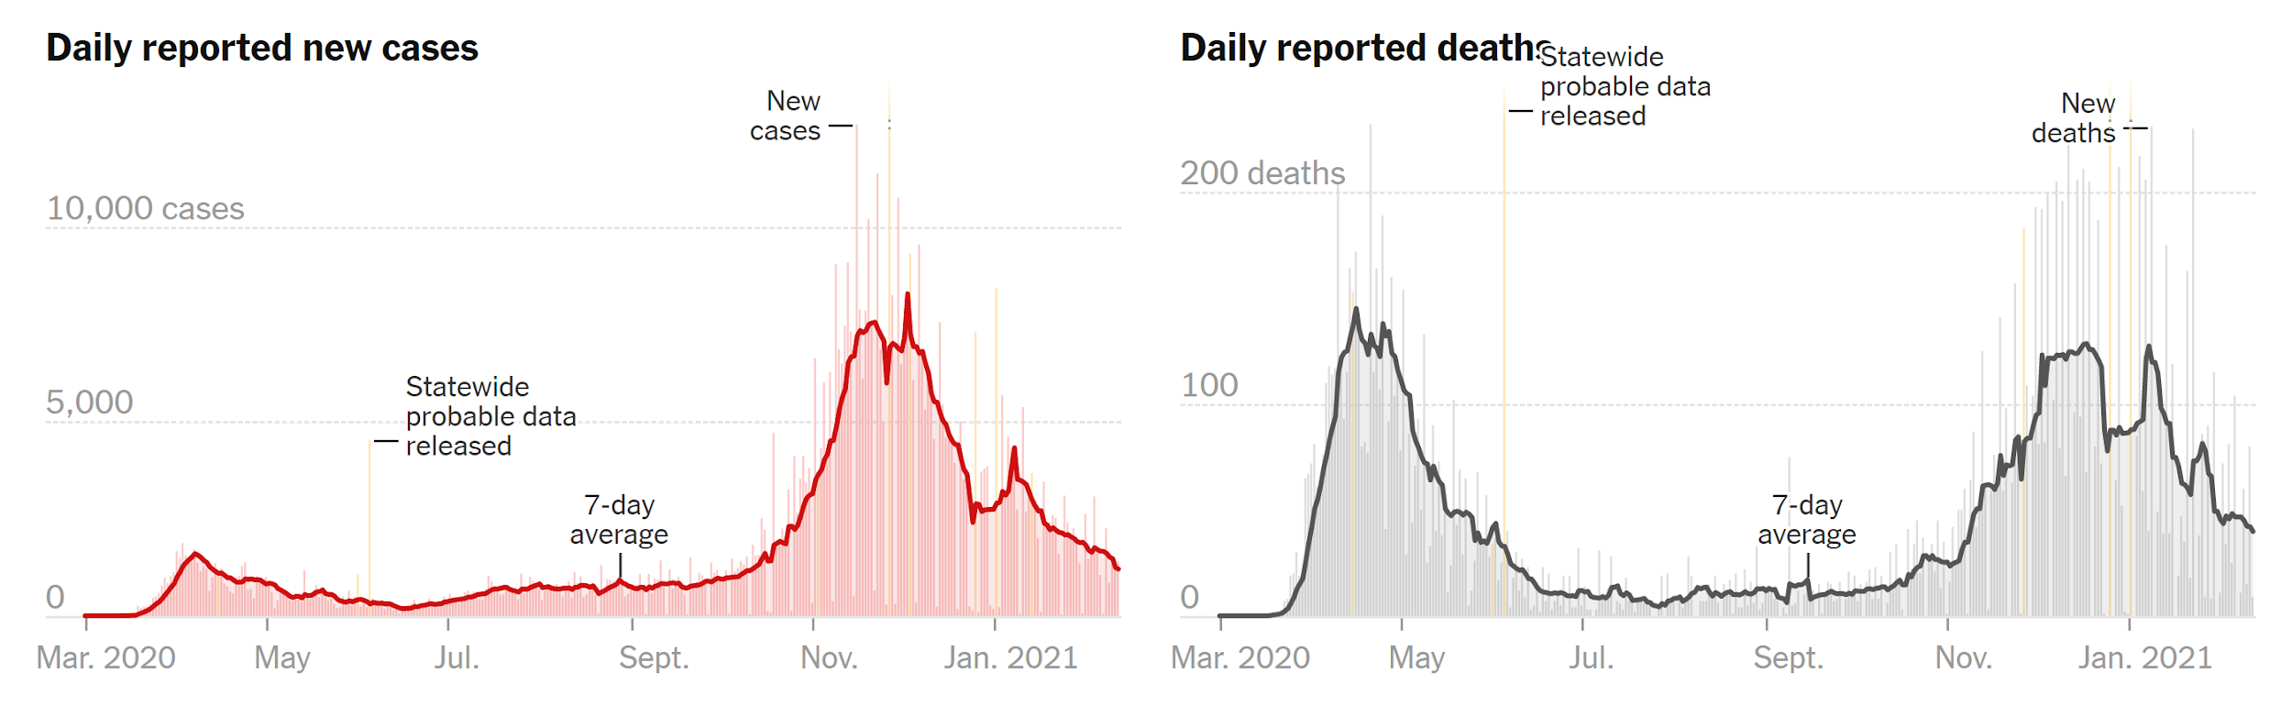
Main Findings and Conclusions:

Slide 12
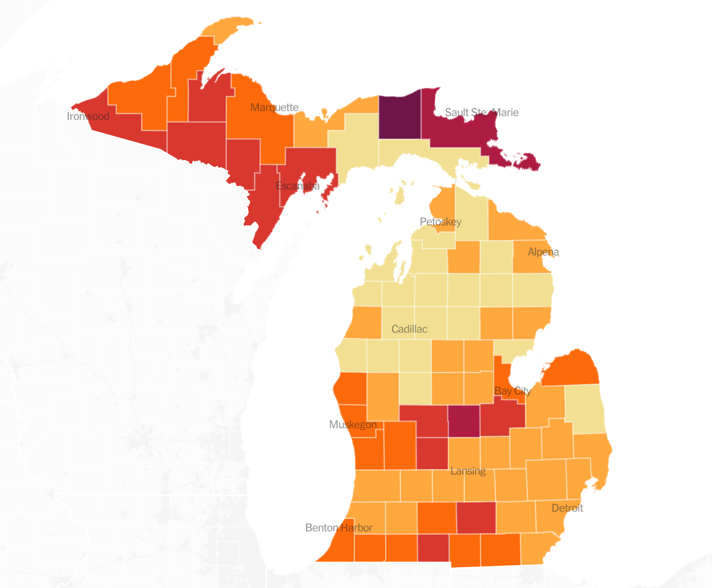
*Number of cases per capita

Slide 13


What is the basic reproductive number for Covid-19?
Ro
Notes:
Exactly how contagious is COVID 19 and does it matter where in the world you are. We know that the susceptible population is a factor in calculating the basic reproductive number, so how do different populations affect the results.

Slide 14


Information:
The basic reproduction number of the new coronavirus pandemic with mortality for India, the Syrian Arab Republic, the United States, Yemen, China, France, Nigeria and Russia with different rate of cases
(https://www.ncbi.nlm.nih.gov/pmc/articles/PMC7438206/)
Notes:
Title: The basic reproduction number of the new coronavirus pandemic with mortality for India, the Syrian Arab Republic, the United States, Yemen, China, France, Nigeria and Russia with different rate of cases
Webpage: National Center for Biotechnology Information (https://www.ncbi.nlm.nih.gov/pmc/articles/PMC7438206/)
Author: Marwan Al-Raeei
Credentials: Faculty of Sciences, Damascus University
Research Fields: Chemistry, Physics, and Mathematics

Slide 15

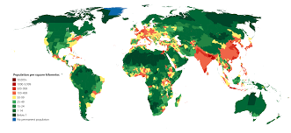
Purpose:
+
Ro
Notes:
Investigate the impact of culture and population density on Ro. Different cultures interact in different ways. Cultures where people spend more time near each other, or have a greater chance of interacting and having physical contact my increase the viruses ability to be trasfered.
This data is beneficial information for future epidemics because it quantifies the differences between cultures and how a viruses ability to spread compares.

Slide 16
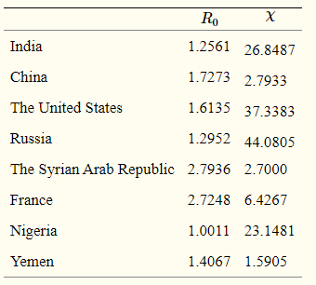


Main Findings and Conclusions:
Basic Reproductive Number
Low: 1.0011 (Nigeria)
High: 2.7936 (The Syrian Arab Republic)
Rate of Recovery and Rate of Mortality Ratio
Low:1.5905 (Yemen)
High: 44.0805 (Russia)
Notes:
Nigeria has the lowest basic reproductive number at 1.0011, while the syrian arab republic has the highest at 2.7936. This provides proof that different cultures produce different basic reproductive numbers. However, in every case the basic reproductive number is greater than 1, meaning it is an epidemic in all investigated countries.
The Ratio of rate of recovery over rate of mortality does not necessarily correspond to the basic reproductive number though. This study shows that Yemen has the worst ratio with 1.59 while Russia has the best at greater than 44

Slide 17



Will new vaccines need to be made to fit COVID mutations similar to the flu shot?
Notes:
As vaccines start to become available, much of the public is worried that it is too late and that the virus will have mutated to work against the vaccine. Will the vacines that are comming out now be effective against these mutations?

Slide 18
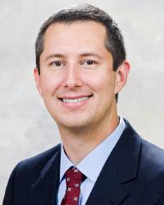


Information:
How COVID-19 mutates and how it affects vaccines
(https://www.osfhealthcare.org/blog/how-covid-19-mutates-and-how-it-affects-vaccines/)
Notes:
Title: How COVID-19 mutates and how it affects vaccines
Webpage: OSF Healthcare (https://www.osfhealthcare.org/blog/how-covid-19-mutates-and-how-it-affects-vaccines/)
Author: Dr. Douglas Kasper
Credentials: Head of infectious disease at University of Illinois College of Medicine
Research Fields: Infectious Disease, Internal Medicine

Slide 19
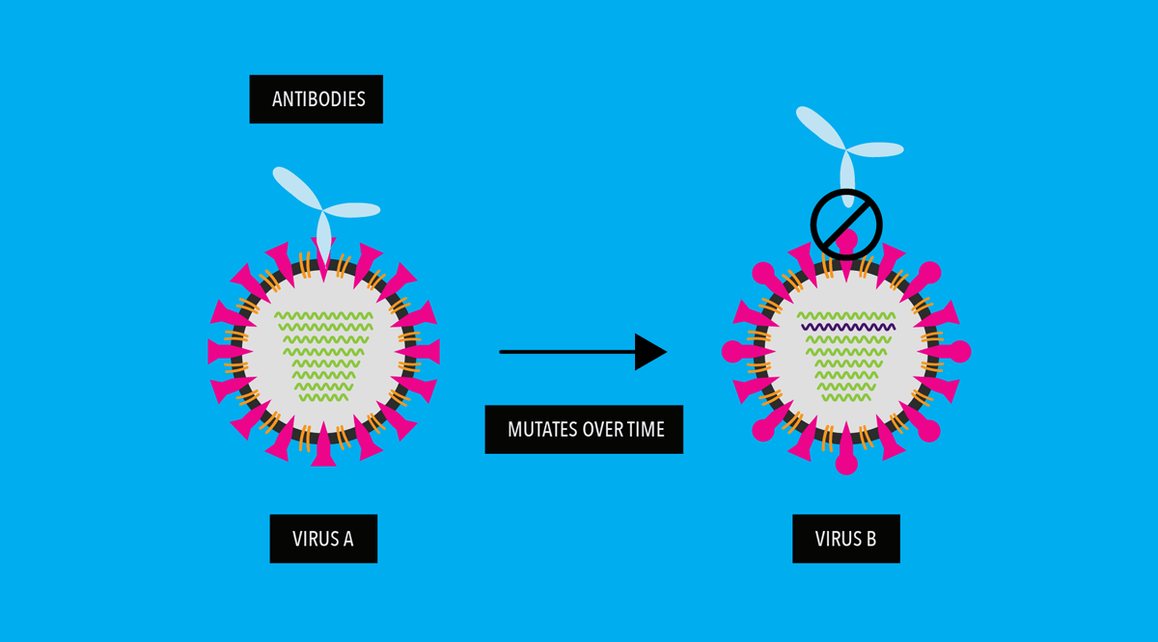
Purpose:
Notes:
The purpose of this article is to determine if research efforts should or are being made to develop vaccines that keep up with COVID mutations
Notify concerned citizens of the impact of a mutating COVID virus, the more well educated the public is the better prepared they are to make necessary decisions

Slide 20



Main Findings and Conclusions:
Two Types of mutations
Drift Shift
Minor alterations due to Shift mutations
Notes:
There are two types of mutations, Drift and Shift. Drift mutations are slight changes to the protein structure but they should not be a problem because they are typically recognized by our immune system. While the shift mutations are a more drastic change to the structure of the virus the way the current vaccine has been set us is that any accomodation needed to be made will only require an adjustment to the mRNA code. This means that the alterations can be made swiftly and prevent any future breakouts of mutated COVID 19 viruses.

Slide 21
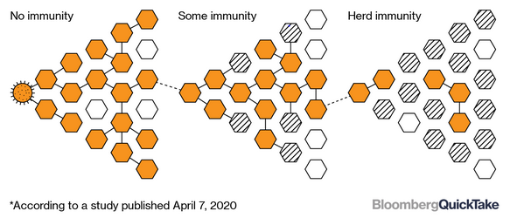
What is the minimum percent of population required to be vaccinated in order to achieve herd immunity?
Notes:
Script: According to Ogbuagu, herd immunity can start to take place with COVID-19 when we reach 75% of the population being vaccinated. This is based on factors such as the reproductive rate of COVID-19 and amount of population susceptible to the virus. It is noted that it is important to keep in mind that due to the limited availability of vaccines, more adults taking the vaccine would lead to faster progress. Estimates say that herd immunity should be possible starting in mid to late 2021.

Slide 22

Information:
The New COVID-19 Vaccine: Answers to All the Hard Questions
https://www.yalemedicine.org/news/covid-19-vaccine
Notes:
Script: This information was provided through Onyema Ogbuagu (on-yay-ma oog-bwag-u), an infectious disease expert at Yale Medicine who is also in charge of leading their COVID-19 clinical studies.

Slide 23
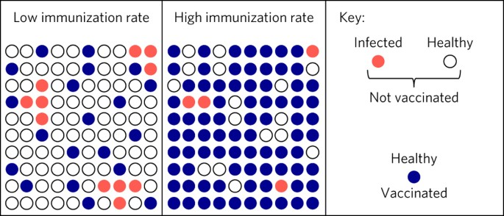
Purpose:
Notes:
The reason for Yale to publish this “The New COVID-19 Vaccine: Answers to All the Hard Questions” is to give some reason behind many frequently asked COVID-19 related questions that may hopefully get the reader to do further research.

Slide 24

Conclusion:
Notes:
This information shows that herd immunity is ultimately not very far of a stretch anymore as we are a few months into 2021.

Slide 25
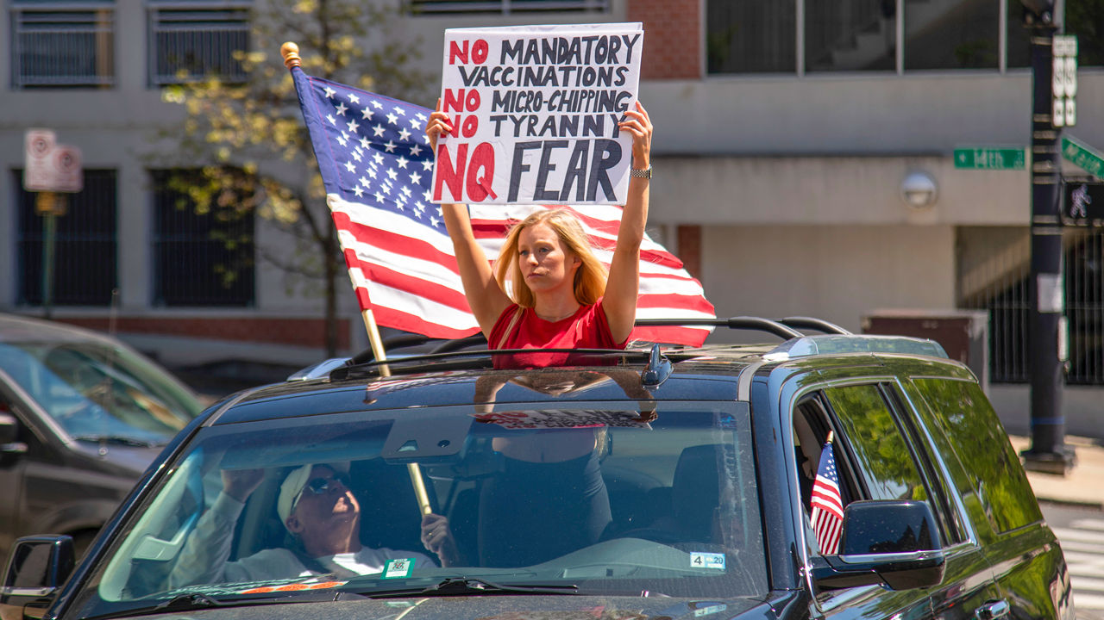
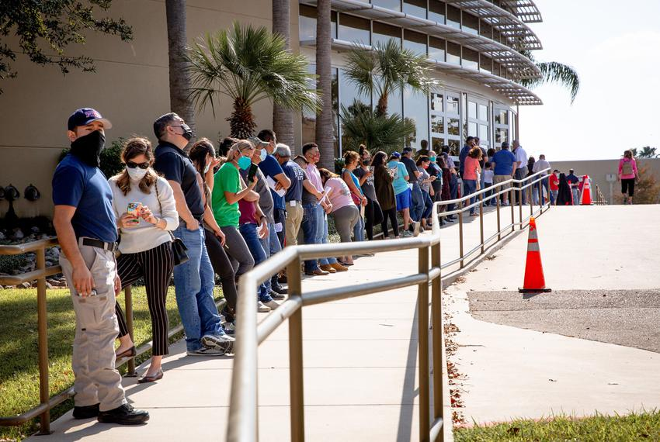
Are enough people willing to receive the COVID-19 vaccine in order to reach herd immunity?
VS.
Notes:
69% of the participants of a survey were willing to receive the COVID-19 vaccine. This survey included 2006 participants who are 18 years or older. Of these participants, it showed that people were much more likely to receive the vaccination if their healthcare provider recommends it. The study also shows that those who are politically moderate or liberal are more likely to get vaccinated or are more worried about a COVID-19 infection impacting them or a loved one. Those who were less likely to get the vaccine also reported that higher levels of "perceived potential vaccine harms". Keeping in mind that it is between 70-75% of the U.S. population that needs to get vaccinated, it is likely that as time goes on some people will be convinced by hearing positive things about the vaccine. In that case, reaching the goal of obtaining ~75% of the population vaccinated is not too far of a goal.

Slide 26

Information:
Acceptability of a COVID-19 Vaccine Among Adults in the United States: How Many People Would Get Vaccinated?
https://www.sciencedirect.com/science/article/pii/S0264410X20310847
Notes:
Statistics shown are from a study performed by Paul Reiter, Michael Pennell, and Mira Katz of the College of Public Health at Ohio State University. The study in the article, “Acceptability of a COVID-19 Vaccine Among Adults in the United States: How Many People Would Get Vaccinated?” aims to provide analysis to experts that are trying to get the public to receive the vaccine when available to them.

Slide 27
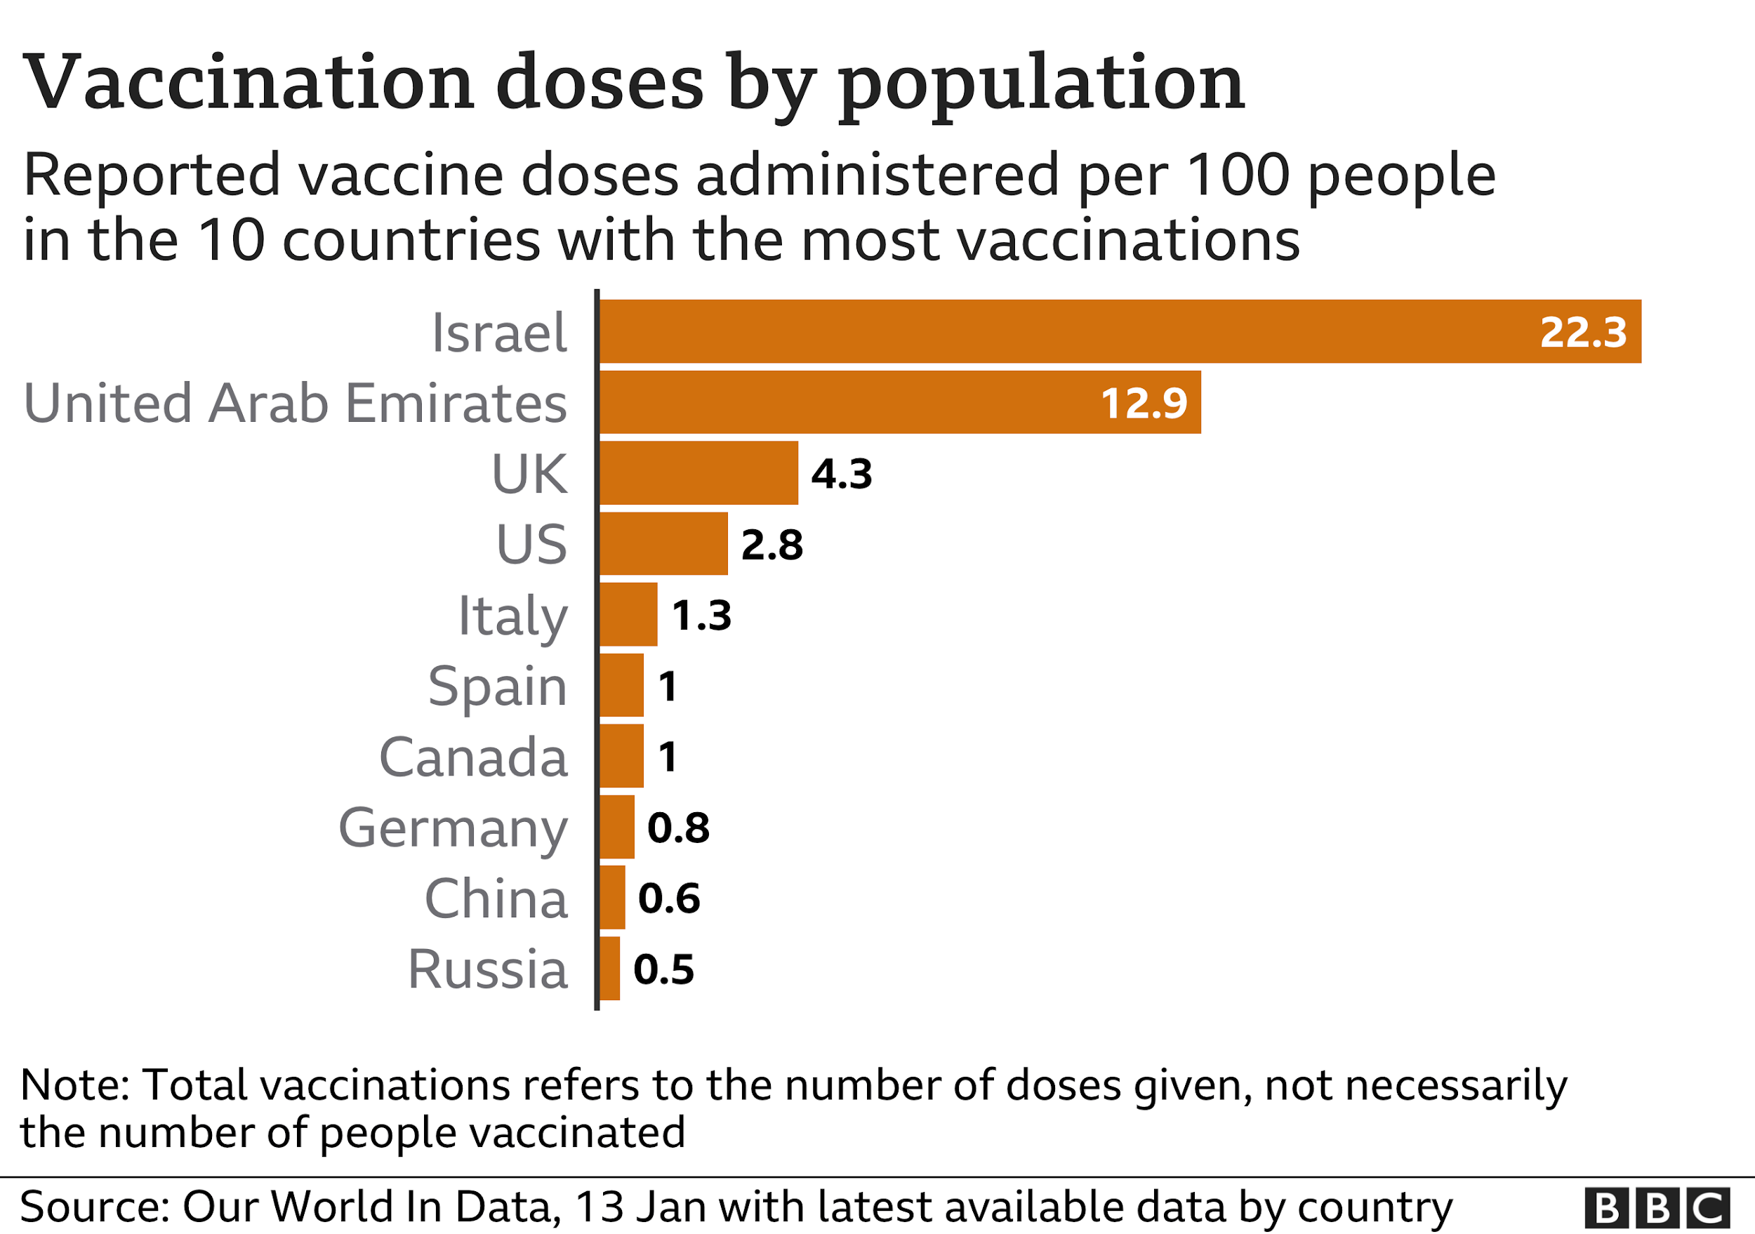
Purpose:
Notes:
The main purpose for this study is to find out what groups of people are more likely to receive the vaccine and which we should “target” more so that we can protect ourselves and others.

Slide 28
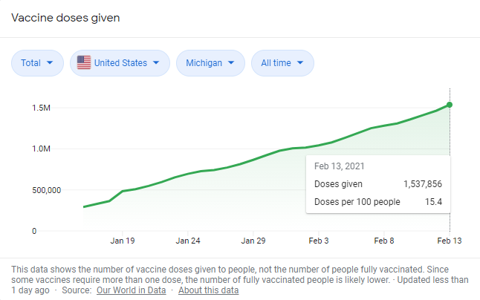
Conclusion:
Notes:
We can reach herd immunity quicker as long as select groups of people agree to receive the vaccination. Should people continually refuse, it just prolongs the current situation.

Slide 29
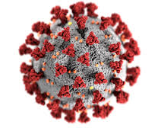

Group Conclusions:
Notes:
Autumn: From February-December 2020 there have been approximately 83.1 million estimated total infections across the United States. In Michigan, there have been a total of 620,186 cases since the pandemic has started. These are estimates which have given insight as to how many people this virus has infected, and not every single case has been able to be documented.
Colin: The goal of herd immunity is not very far out of reach, and with the expected success of the vaccine, hopefully more people will also be convinced in doing their part toward herd immunity.
Austin: Basic reproductive number can vary greatly depending on where you are, however Covid is an epidemic everywhere. Also, mutating Covid viruses should not cause an issue with the current vaccine.

Slide 30
References:
https://www.ethos3.com/2018/05/give-great-pecha-kucha-talk/
https://www.cdc.gov/coronavirus/2019-ncov/cases-updates/burden.html
https://www.nytimes.com/interactive/2020/us/michigan-coronavirus-cases.html#map
https://www.osfhealthcare.org/blog/how-covid-19-mutates-and-how-it-affects-vaccines/
https://www.ncbi.nlm.nih.gov/pmc/articles/PMC7438206/
https://www.yalemedicine.org/news/covid-19-vaccine
https://www.sciencedirect.com/science/article/pii/S0264410X20310847

